Slide 1

Introduction to Arrays

Slide 2
Index
Introduction to Arrays
Array declaration and creation
Array initialization
Array Traversal
length vs length()
Array of objects

Slide 3
Introduction to Arrays
Primitive variables are designed to hold only one value at a time
Arrays allow us to create a collection of like values that are indexed.
An array can store any type of data but only one type of data at a time
In other words we can say that an array is an indexed collection of, fixed number of, homogeneous data elements.

Slide 4

Creating Arrays
An array is an object so it needs an object reference.
// 1st Step - Declare a reference to an array that will hold integers.
Int [] arrayofnumbers;
// 2nd Step - create a new array that will hold 5 integers.
arrayofnumbers = new int[5]
Index 0 index 1 index 2 index 3 index 4
Array element values are initialized to 0. Array indexes always start at 0.

Slide 5
Creating Arrays- Cont.
It is possible to declare an array reference and create it in the same statement
// Declaring and creating in one step
int [] arr = new int[10];
Note: Once created, an array size is fixed and cannot be changed.
// Declaring , creating and initializing in one step
int arr[] = {10,20,30,40,50};
Note: Arrays may be of any type
String names[] = new String[10];
double [] sizes = new double[10];

Slide 6
Accessing the Elements of an array
An Array is accessed by -
The reference name
An index that identifies which element in the array to access.
Example :- int arr[]= new int[5];
10
0
0
0
0
arr[0] arr[1] arr[2] arr[3] arr[4]
arr[0] = 10; // value at index zero

Slide 7
Traversing an Array to initialize
Scanner s= new Scanner(System.in); // using the scanner class to get the input from user
int [] arr = new int[10];
for(int i =0;i<10;i++) // traversing an array to initialize
{
System.out.println(“Enter a value”);
arr[i] = s.nextInt();
}

Slide 8
Traversing an Array to access values
for(int i =0;i<10;i++)
{
System.out.println(arr[i]);
}
The Enhanced for Loop – an alternative to accessing the array
for(int element : arr)
{
System.out.println(element);
}
Enhanced for-Loops = simplified array processing (read only)
Always goes through all elements
for(datatype elementVariable : array)
{ statement;}

Slide 9
The length field & the length method
Arrays have a final field named length.
Use the .length field to check for bounds
for(int i =1; i < arr.length ; i++)
{
arr[i] = 10;
}
String Objects have a method named length() to find the length of the String.

Slide 10
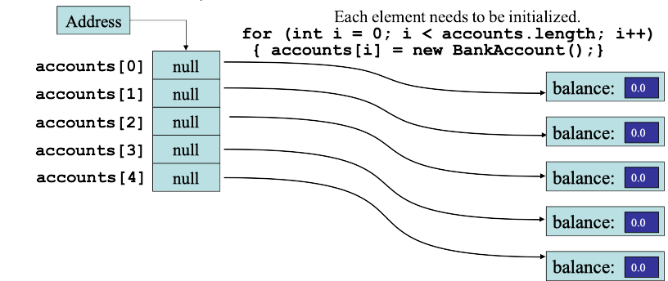
Arrays of Objects
This is an array of reference to BankAccount object: (Think BankAccount is a class)
BankAccount [] accounts = new BankAccount[5];
The accounts variable holds the address
of an BankAccount array.

Slide 11
References
Starting Out with Java: From Control Structures through Data Structures @ 2012 pearson Education
Hyperskil Academy by jetbrains.

